Slide 1
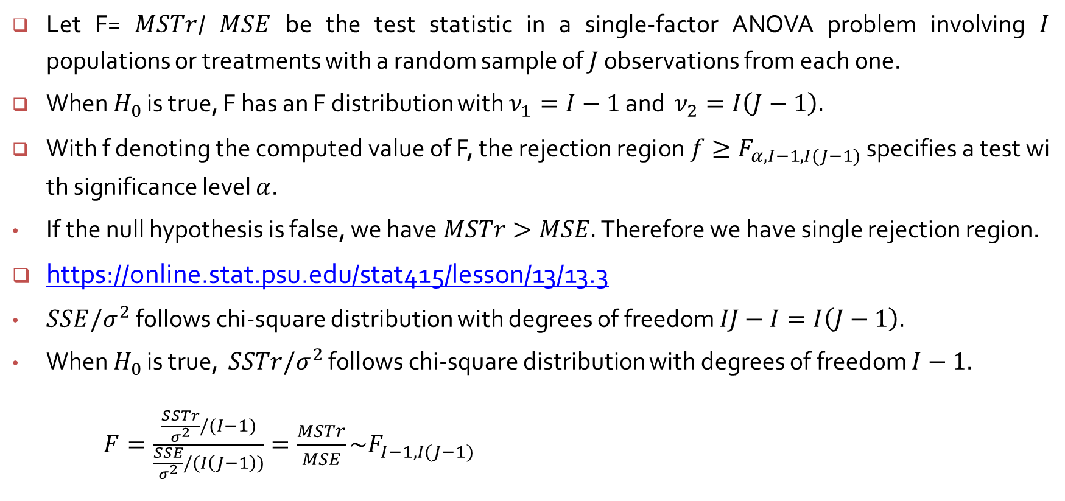
F Distribution and the F Test
Let F= $MSTr$/ $MSE$ be the test statistic in a single-factor ANOVA problem involving $I$ populations or treatments with a random sample of $J$ observations from each one.
When $H_{0}$ is true, F has an F distribution with $ν_{1}=I−1$ and $ν_{2}=I\left(J−1\right).$
With f denoting the computed value of F, the rejection region $f≥F_{α, I−1, I(J−1)}$ specifies a test with significance level $α$.
If the null hypothesis is false, we have$MSTr>MSE.$Therefore we have single rejection region.
https://online.stat.psu.edu/stat415/lesson/13/13.3
$SSE/σ^{2}$ follows chi-square distribution with degrees of freedom $IJ−I=I\left(J−1\right).$
When $H_{0}$ is true, $SSTr/σ^{2}$ follows chi-square distribution with degrees of freedom $I−1$.
$F=\frac{\frac{SSTr}{σ^{2}}/(I−1)}{\frac{SSE}{σ^{2}}/(I\left(J−1\right))}=\frac{MSTr}{MSE}\sim F_{I−1, I(J−1)}$

Slide 2
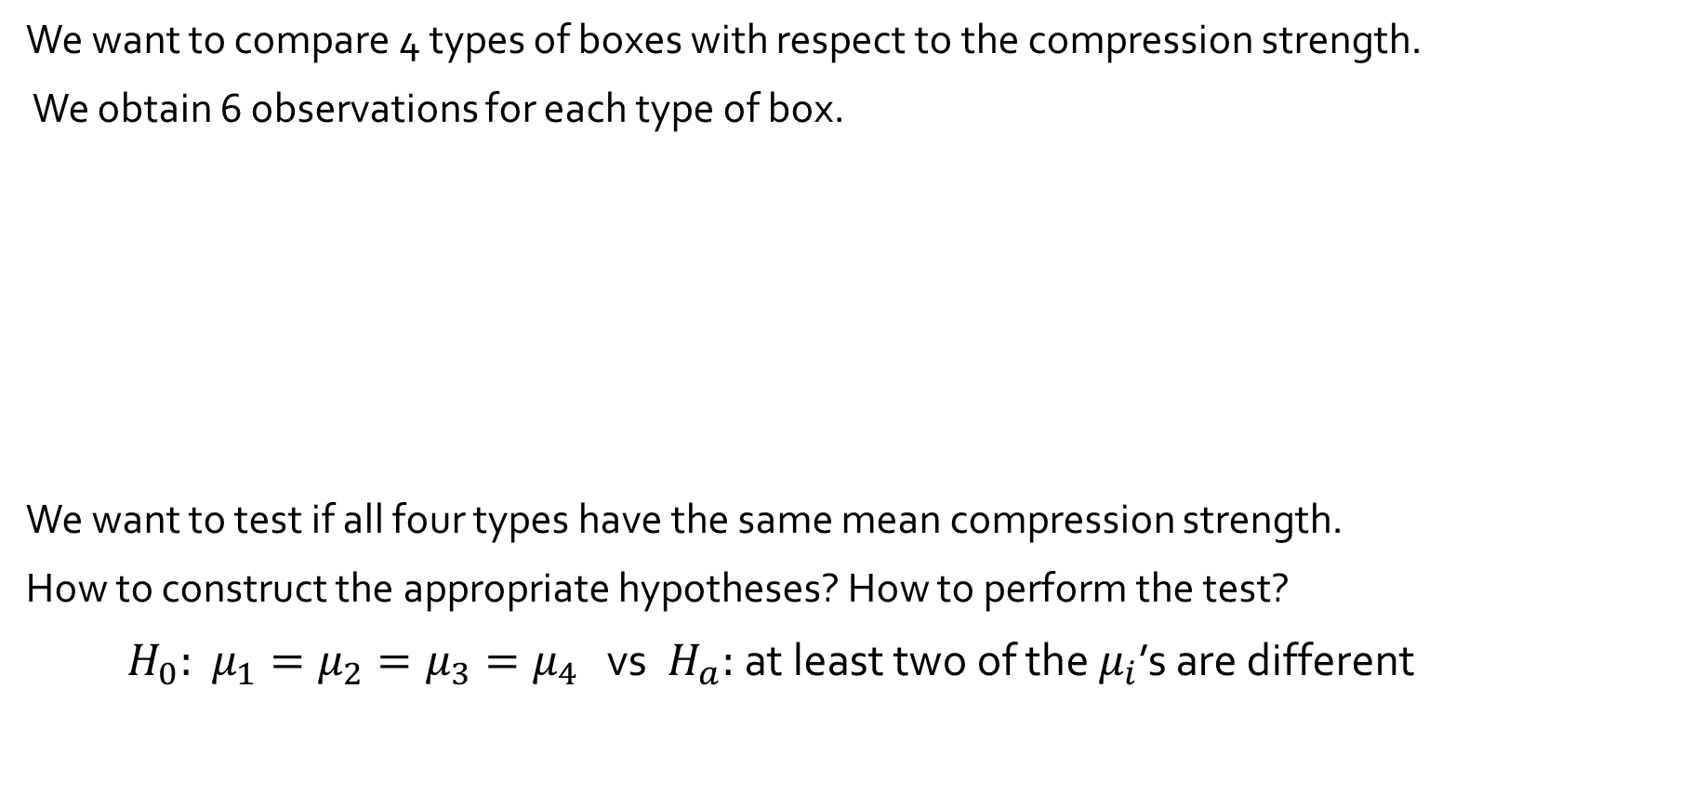
10.1 Single Factor ANOVA Example 10.1
We want to compare 4 types of boxes with respect to the compression strength.
We obtain 6 observations for each type of box.
We want to test if all four types have the same mean compression strength.
How to construct the appropriate hypotheses? How to perform the test?
$H_{0}:$ $μ_{1}=μ_{2}=μ_{3}=μ_{4}$ vs $H_{a}:$ at least two of the $μ_{i}$’s are different
Type of Box | Compression Strength (lb) | Sample Mean | Sample SD
1 2 3 4 | 655.5 788.3 734.3 721.4 679.1 699.4 789.2 772.5 786.9 686.1 732.1 774.8 737.1 639.0 696.3 671.7 717.2 727.1 535.1 628.7 542.4 559.0 586.9 520.0 Grand mean = | 713.00 756.93 698.07 562.02 682.50 | 46.55 40.34 37.20 39.87

Slide 3
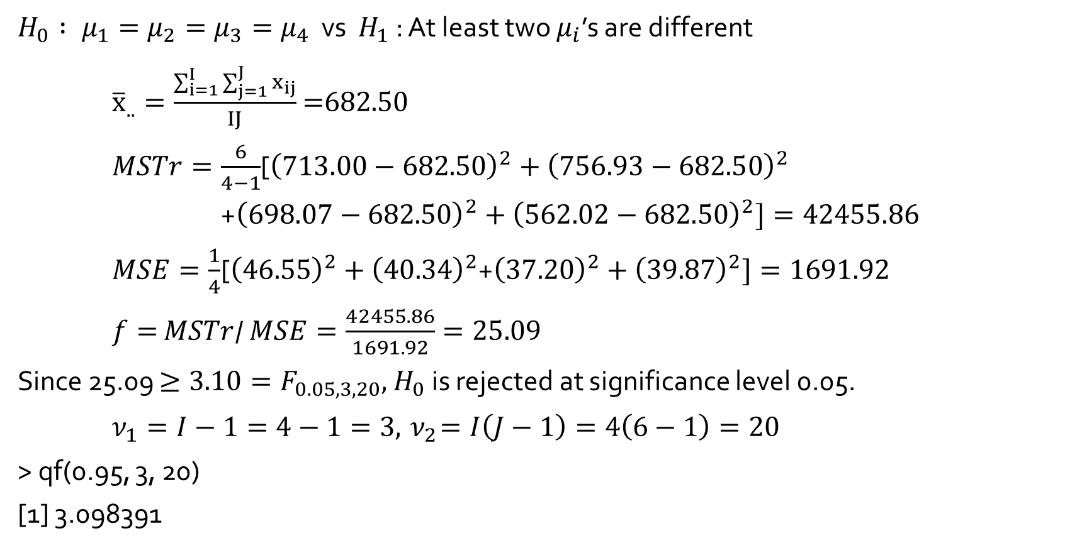
Example 10.2 (Example 10.1 continued) :
$H_{0} : μ_{1}=μ_{2}=μ_{3}=μ_{4}$ vs $H_{1}$ : At least two $μ_{i}$’s are different
${\overline{x}}_{..}=\frac{\sum_{i=1}^{I}{\sum_{j=1}^{J}{x_{ij}}}}{IJ}$ =682.50
$MSTr=\frac{6}{4−1}$[${\left(713.00−\text{682.50}\right)}^{2}+{\left(756.93−\text{682.50}\right)}^{2}$
+${\left(698.07−\text{682.50}\right)}^{2}+{\left(562.02−\text{682.50}\right)}^{2}]=42455.86$
$MSE=\frac{1}{4}$[${\left(46.55\right)}^{2}+{\left(40.34\right)}^{2}$+${\left(37.20\right)}^{2}+{\left(39.87\right)}^{2}]=1691.92$
$f=$ $MSTr$/ $MSE=\frac{42455.86}{1691.92}=25.09$
Since 25.09 $≥3.10=F_{0.05, 3, 20},{ H}_{0}$ is rejected at significance level 0.05.
$ν_{1}=I−1=4−1=3, { ν}_{2}=I\left(J−1\right)=4\left(6−1\right)=20$
> qf(0.95, 3, 20)
[1] 3.098391

Slide 4
R execution of Example 10.1
> compression <- c(655.5,788.3,734.3,721.4,679.1,699.4,
+ 789.2,772.5,786.9,686.1,732.1,774.8,
+ 737.1,639.0,696.3,671.7,717.2,727.1,
+ 535.1,628.7,542.4,559.0,586.9,520.0)
> type <- c(rep("1", 6), rep("2", 6), rep("3", 6), rep("4", 6))
> oneway <- aov(compression ~ type)
> summary(oneway)
Df Sum Sq Mean Sq F value Pr(>F)
type 3 127375 42458 25.09 5.53e-07 ***
Residuals 20 33839 1692
---
Signif. codes: 0 ‘***’ 0.001 ‘**’ 0.01 ‘*’ 0.05 ‘.’ 0.1 ‘

